Slide 1
Direct Marketing Campaign
A classification problem

Slide 2
Problem Statement
The data is related with direct marketing campaigns of a Portuguese banking institution. The marketing campaigns were based on phone calls. Often, more than one contact to the same client was required, in order to access if the product (bank term deposit) would be ('yes') or not ('no') subscribed. There are four datasets: 1) bank-additional-full.csv 2) bank-additional.csv 3) bank-full.csv 4) bank.csv The classification goal is to predict if the client will subscribe (yes/no) a term deposit (variable y).

Slide 3
Steps performed
Train a basic model
Exploratory Data Analysis
Feature Engineering
Retrain model for greater accuracy

Slide 4
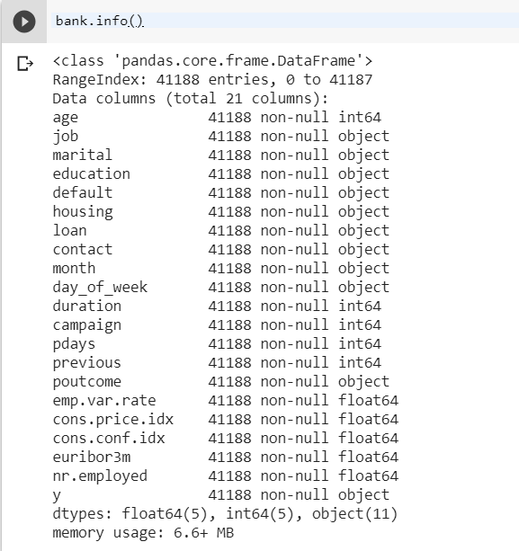
Data set details

Slide 5
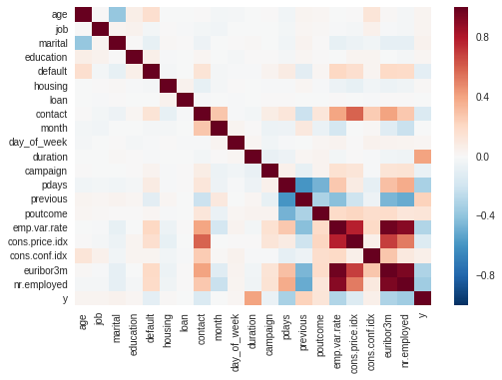
Correlation between input variables
Very little correlation between variables.

Slide 6
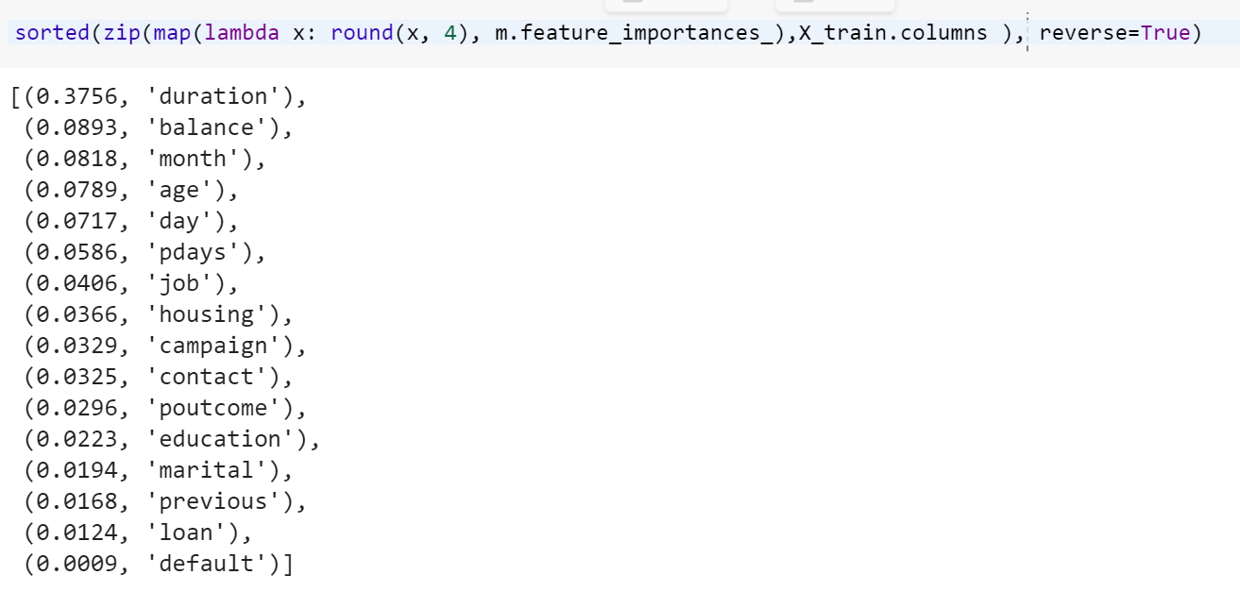
Feature selection

Slide 7
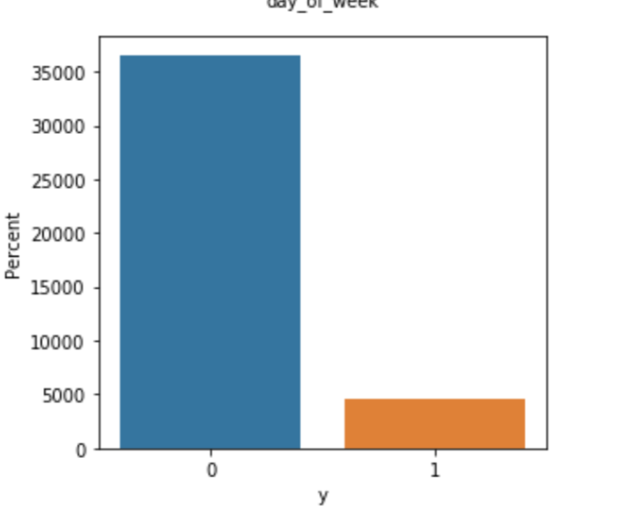
Countplot of target variable
Target variable is very imbalanced.

Slide 8
Observations after EDA and data prep
There is very little correlation between variables so nothing can be dropped.
There were many outliers in Age column, which we handled by converting it into group categorical variable and then label encoding.
The ‘duration’ is dropped for a realistic model.
The target variable is unbalanced. We need to employ oversampling or undersampling.

Slide 9
Model tuning
Random forest was tuned on four parameters.
Number of estimators
Max depth
Max features
Criterion
GridSearchCV was used to find the appropriate value of the paramters mentioned above.

Slide 10
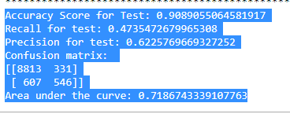
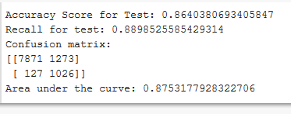
Model parameters
Initial Model
Final Model

Slide 11
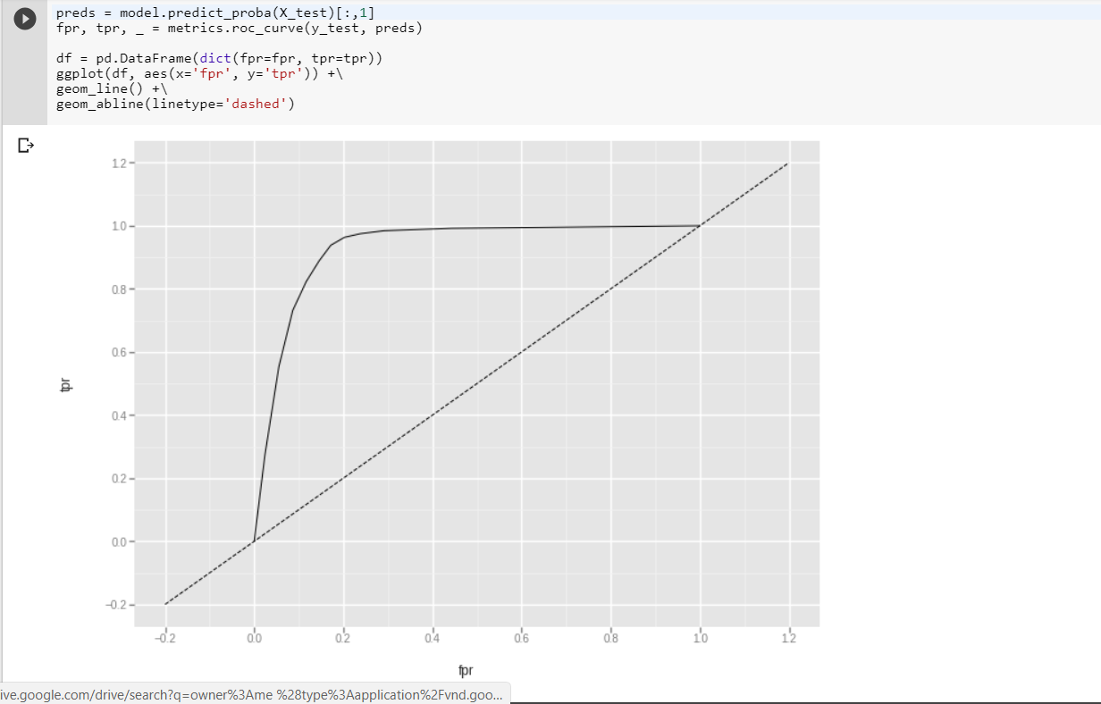
ROC curve

Slide 12
Github link:
https://github.com/kishangooner/feature_selection_project/blob/master/Campaign.ipynb

